Slide 1
State of .NET
Toni Solarin-Sodara
Microsoft MVP Software Developer, Andela

Slide 2
Agenda
Where are we at? How do we develop today? Not just MS stuff.
What’s new with .NET?
What’s new with Visual Studio?
What’s new with Web Development?
What’s new with Windows?
What’s new with the Cloud?

Slide 3
Microsoft Today

Slide 4
The “New Microsoft”
Microsoft is Back!!!
My non-Microsoft take on things:
Microsoft is back to being the friendlier, cooler Microsoft!
Microsoft is back to building cool new stuff that’s actually exciting!
Microsoft is back as the leader in OS innovation
Microsoft is building incredible Enterprise-level software
Microsoft’s developer ecosystem is growing rapidly
Microsoft’s customer satisfaction ratings are outstanding
Very rapid developments

Slide 5




Embracing Everything
In the past, Microsoft can be seen as “Windows only”
Today, Microsoft embraces all developers and all platforms

Slide 6

The “Open Microsoft”
Strategic move to Open Source
Example: ASP.NET Core
Strategic move to embracing all technologies and platforms

Slide 7
.NET

Slide 8
.NET Core
Re-write of the .NET Runtime
Re-envisioning of .NET for today’s scenarios

Slide 9
.NET Standard
Standard supported by all implementations of .NET
Think of this as an evolution of portable libraries
Currently 1.x
.NET Standard 2.0 will be a big step forward

Slide 10
.NET Native
“.NET CLR RT”
Single Executable
Drastically lower memory use
Drastically lower startup time

Slide 11
Languages
.NET Languages
C#: Leader of the pack
VB: Still going strong
F#: Darling of a dedicated smaller community
All have a bright future with specific roles to play

Slide 12
Development Environment

Slide 13
Visual Studio 2017
Visual Studio 2017 has been available for quite some time
Tool of choice, even if you have to work on older projects
Out of the box support for .NET Core

Slide 14
Visual Studio 2017 Community Edition
Free version of Visual Studio 2017
You can think of this as “Visual Studio Professional”
Full support for features such as add-ins and extensions
Free for non-Enterprise developers

Slide 15
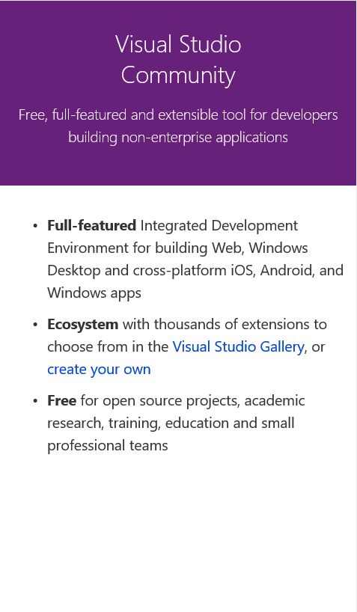
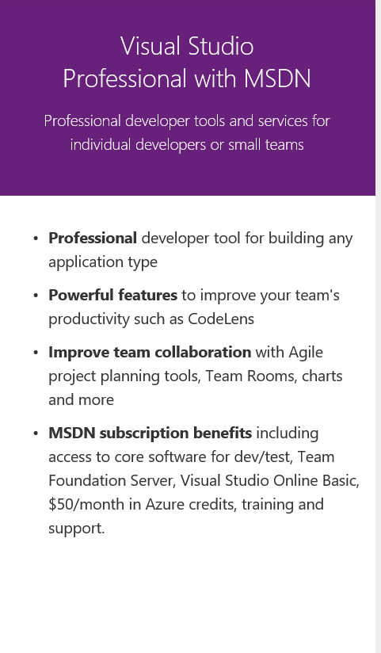
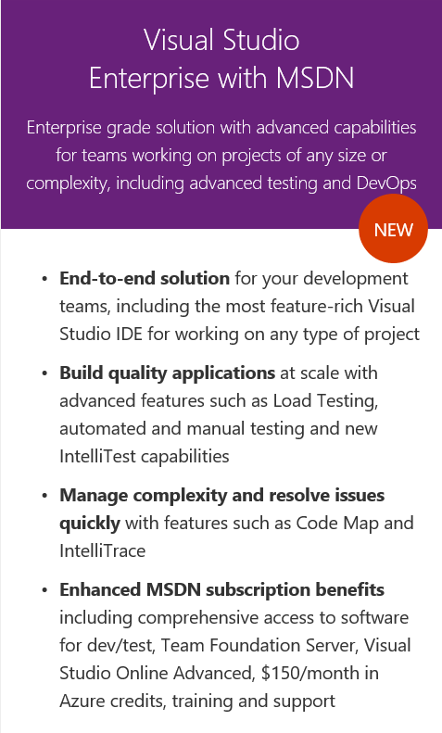
Visual Studio Editions

Slide 16
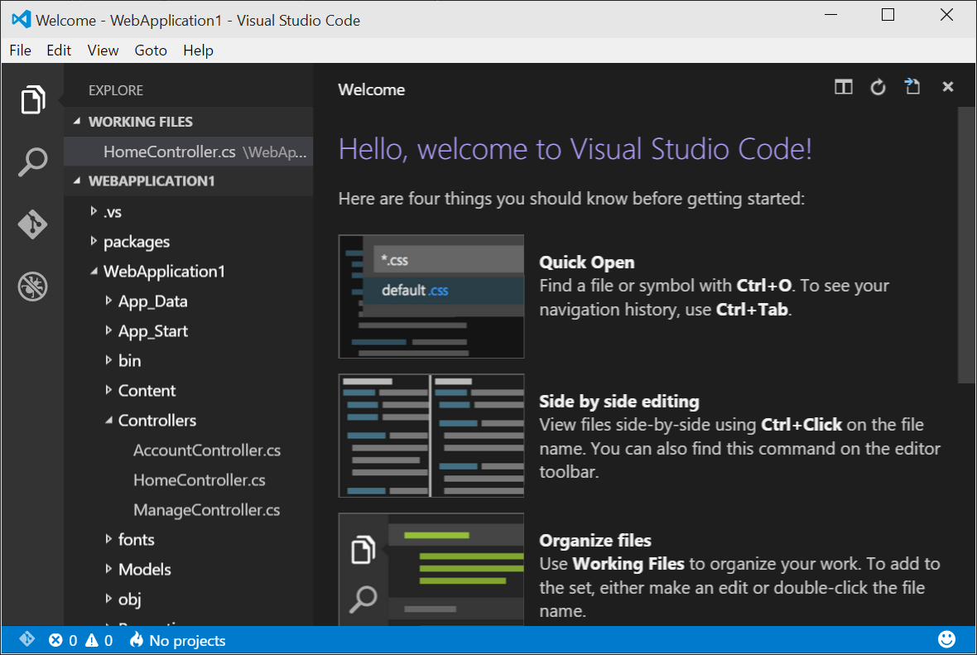
Visual Studio Code
A new, lightweight IDE that is part of the Visual Studio family
Completely free of charge
Runs on Windows, Mac, and Linux
Focus on code
Great for modern web and cloud development
Lots of add-ins
Embraced by the community

Slide 17
Xamarin
Very important for building native mobile apps on iOS, Android, and more… using .NET
Key scenario: Code reuse across platforms

Slide 18
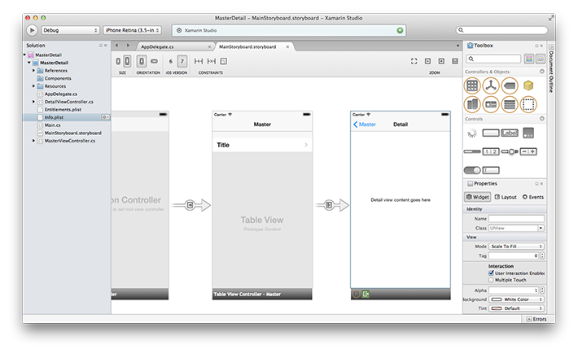
Xamarin Studio
Xamarin IDE for Mac
Geared towards creating iOS apps with Xamarin
Can also be used for Mac

Slide 19
Web Development

Slide 20
General Overview of Web Development
ASP.NET for server-side development
How much server-side development do you need?
HTML5 client-side development
React seems to be the winner

Slide 21
ASP.NET

Slide 22
Problems with “Classic” ASP.NET Architecture
Limited hosting capabilities (IIS only)
Dependency on IIS environment (System.Web)
Web evolves faster than the .NET Framework
Requires full .NET Framework
Resource-intensive and not Web/Cloud friendly
Hard to optimize and scale down for lightweight apps
How much server-side processing do you really need?

Slide 23
ASP.NET Core
ASP.NET Core is a complete re-write of ASP.NET
Modular and not platform dependent
The ASP.NET Framework now comes in lots of tiny packages that are brought in through NuGet
Pick and choose the features and components you would like to use
Better suited for Cloud-operations
MVC 6
No separate WebAPI, no more WebForms

Slide 24
Introducing ASP.NET Core Stack
ASP.NET
Web API
MVC
Web Pages
Middleware
.NET CLR
.NET Core CLR
Host
IIS
Self-hosted
OS

Slide 25
.NET Core vs. Full .NET Runtime
In ASP.NET Core, there are two versions of the .NET Runtime
Full .NET Runtime, and .NET Core
ASP.NET Core runs on both!
.NET Core runs cross platform
Windows, Mac, Linux
.NET Core Runtime is a sub-set of the Full .NET Runtime

Slide 26
A Word about 4.x
There are many features of ASP.NET 4.x that will continue to be supported
It is fine to keep using that version…
…and the full .NET Runtime

Slide 28
HTML 5 Frameworks
There are now quite a few frameworks geared towards writing applications based on top of HTML5
Single Page Applications – SPAs
Angular, Amber, React, Aurelia,…
React seems to emerge as the clear #1
Nevertheless, others are viable options as well

Slide 29
Containers
Containers isolate environments (“virtualization”)
Contrary to virtual machines, containers do not include a virtualized OS
Containers are typically lightweight

Slide 30

Docker
Docker is supported on Windows as well as Linux
.NET Core is great for deploying to Docker…
…but the full framework works as well
But it is not as lightweight
Docker is becoming the “de-facto” standard of “Unit of Deployment”

Slide 31
Windows Development

Slide 32
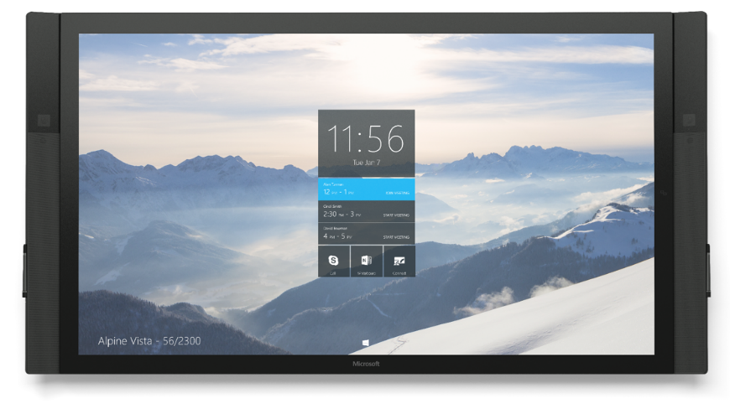
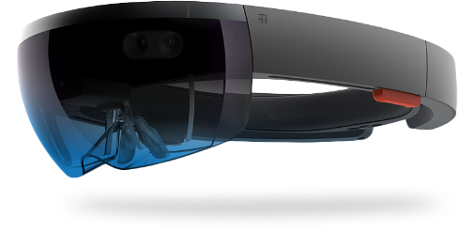
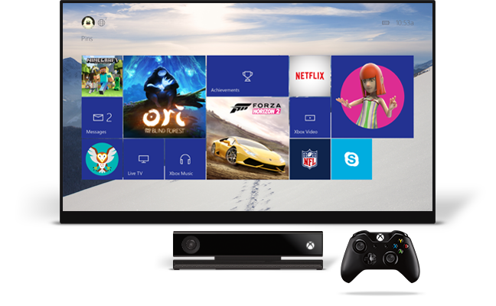
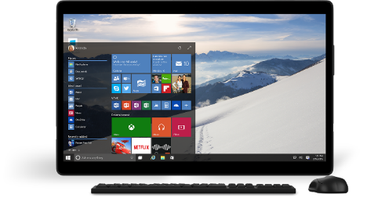

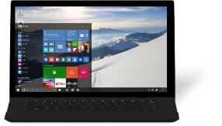
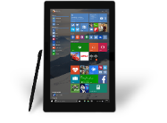



One converged platform

Slide 33
One Windows
Desktop SKU
Mobile SKU
Xbox SKU
IoT SKU
IoT headless SKU
Surface Hub SKU
Holographic SKU
PC
Tablet
Xbox
Band
Raspberry Pi
Surface Hub
HoloLens
Home Automation
2 in 1
Phablet
Phone

Slide 34
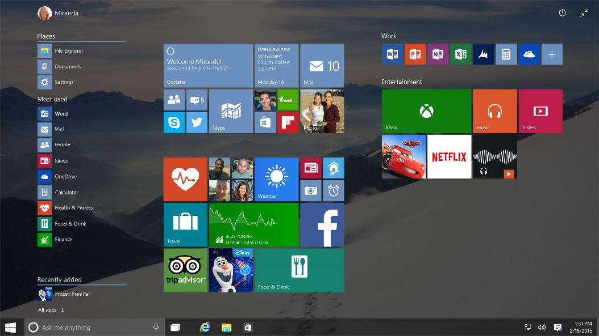
Continuum
Dynamically switches the interface between the Desktop PC and 2-in-1 Tablet mode that’s better suited for fingers
Tablet Mode setting is also available in Action Center.

Slide 35
Universal App Platform
You can now build one app that runs on all Windows 10 devices
Desktop, slate, mobile, headless, Xbox, Surface Hub,…
Universal Apps are now much more powerful and “normal”
Universal Apps can be seen as a new way to build powerful desktop apps, and more
They support most things you would expect from a typical windows app
These are also the apps that run on HoloLens or Raspberry Pi

Slide 36
What are Windows Universal Apps?
Windows 10 can execute two types of apps
“Conventional Windows Apps” based on “Win32 style architecture”
“Desktop Apps”, 32 bit or 64 bit
Run on PCs only
Universal Apps running on a new fundamental tech stack
Formerly “WinRT”, “Store Apps”, “Metro Apps”,…
Run on any hardware (PCs, Phones, Xbox,…)

Slide 37
.NET Native
Every App in the Store is compiled with .NET Native
Likely used for other types of apps in the future
.NET Native is a next-generation compiler in the Cloud
Apps use the standard C++ Compiler
As Optimizer Performance improves, so does .NET Native
Apps with .NET Bootstrapper
Includes Garbage Collection
There is no runtime, since this creates native machine code
Improved startup time and less memory usage

Slide 38
Developing Windows Universal Apps
Visual Studio 2015
Usually done on Windows 10
Although Windows 8.1 is supported
Typically done with XAML and C#
The older HTML-based scenarios is still supported but not pushed

Slide 39
Azure

Slide 40
What is Azure?
Azure is an open and flexible cloud platform that enables you to quickly build, deploy and manage applications across a global network of Microsoft-managed datacenters.
You can build applications using any language, tool, or framework. And you can integrate your public cloud applications with your existing IT environment.

Slide 41
Why the Cloud?
Rapidly setup environments to drive business priorities
Scale to meet peak demands
Increase daily activities, efficiency and reduced cost.
Speed
Scale
Economics

Slide 42
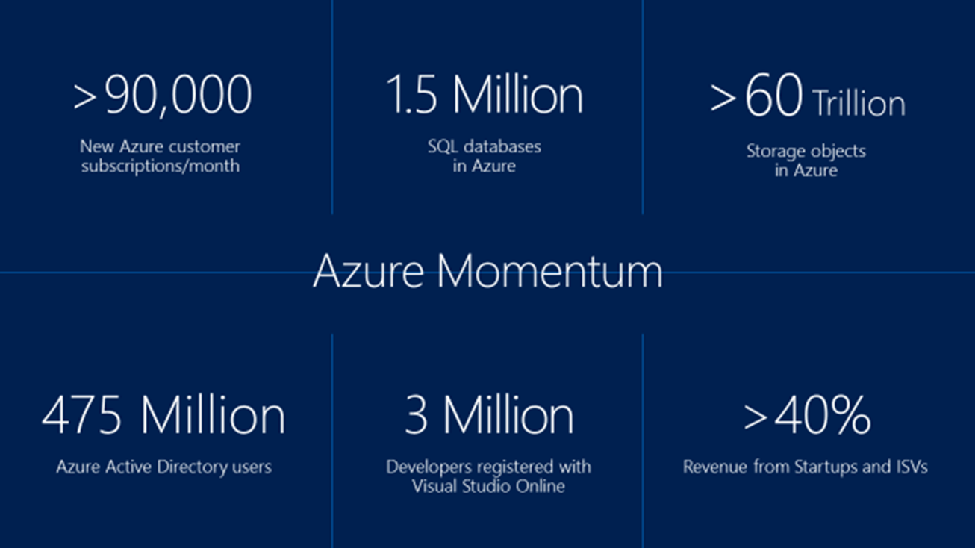
More than
1,000,000
>57%
>300k
>1.65
Fortune 500 using Azure
Active websites
SQL Databases in Azure
>30
>300
TRILLION storage objects
MILLION
AAD users
>3
MILLION requests/sec
>13
BILLION
MILLION
authentication/wk
Developers registered with Visual Studio Online

Slide 43
17 Regions Worldwide in 2015
Azure footprint
Data Centers
Regional Partners

Slide 44
99.9% = 43 minutes/month

Slide 45
A Couple Of Things to Know About Azure
Azure is BIG.
Azure changes almost daily.
The terminology changes a lot too!
There are 2 Azure portals, each with different capabilities.

Slide 46
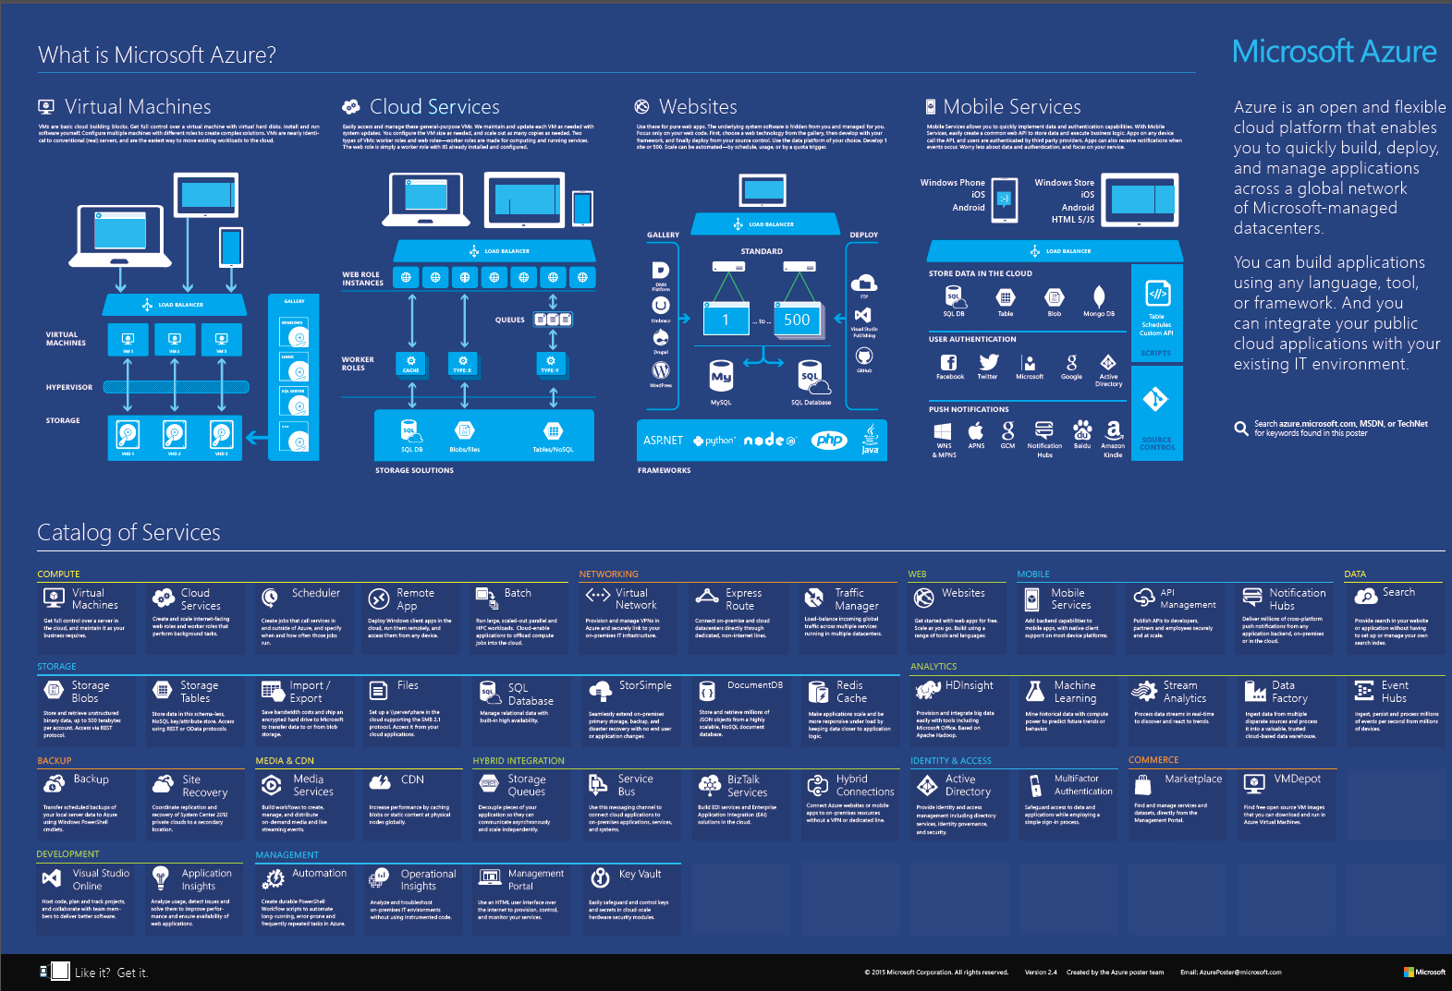

Slide 47
What’s in Azure as of today
Active Directory
API Management
Application Insights
Automation
Backup
Batch
BizTalk Services
Blobs
CDN
Cloud Services
Data Factory
DocumentDB
Event Hubs
Express Route
Files
HDInsight
Hybrid Connections
Import/Export
Key Vault
Machine Learning
Management Portal
Marketplace
Media Services
Mobile Engagement
Mobile Services
MultiFactor Authentication
Notification Hubs
Operational Insights
Power BI (analytics for Excel)
Redis Cache
RemoteApp
Scheduler
Search
Service Bus
Site Recovery
SQL Database
Storage Queues
StorSimple
Stream Analytics
Tables
Traffic Manager
Virtual Machines
Virtual Network
Visual Studio Online
VM Depot
Websites
Note: items in italics are currently in preview

Slide 48
Some other things to take note of
App Services (adds logic (use connectors) & api (create connectors) apps to web and mobile apps)
Windows Azure Pack (software: run an Azure cloud on-prem)
Cloud Platform System (hardware: on-prem cloud from Dell)
Active Directory Application Proxy (secure on-prem web apps & services with Azure AD)
Machine Learning Marketplace (brings data owners and data analyzers together)
Storm for HDInsight (analysis for Hadoop)
HBase for HDInsight (extends Hadoop)
Analytics Platform System Appliance (gateway between on-prem data and cloud analytics)
Live Streaming for Media Services
Visual Studio Emulator for Android
Visual Studio Tools for Apache Cordova
Lots of IOT services coming

Slide 49
A few things that are coming
Storage iOS Library
Availability on Demand (builds on Site Recovery and Backup)
Role-Based Access Control
Network Virtual Appliances (hardware)
Microsoft Identity Manager
Visual Studio Online Release Management
Microsoft just bought Revolution Analytics, the makers of R

Slide 50
Notes for Azure offerings
COMPUTE
Virtual Machines (not just Windows)
Cloud Services (web roles and worker roles)
Scheduler (scheduled jobs call svcs anywhere)
RemoteApp (remote desktop for a single app)
Batch (schedule & scale .exes)
STORAGE
Blobs
Tables (NoSQL key/attribute)
Import/Export (ship encrypted hard drives)
Files (\\server\share\ drive in the sky)
SQL Database (2014)
StorSimple (SAN appliance hybrid storage)
DocumentDB (NoSQL JSON)
Redis Cache (atomic key-value. scale / latency)
NETWORKING
Virtual Network
Express Route (dedicated lines to Azure)
Traffic Manager (load balance traffic.)
WEB
Websites (not just ASP.NET)
MOBILE
Mobile Services (easy services, db, sync)
API Management (API catalog)
Notification Hubs (push notifications to devices)
DATA
Search (index a website or db)
ANALYTICS
HDInsight (Hadoop – big data)
Machine Learning (mine data to make predictions)
Stream Analytics (analyze without storing)
Data Factory (data warehse - multiple sources)
Event Hubs (high throughpt data collection IOT)
BACKUP
Backup (scheduled powershell xfers)
Site Recovery (VM cloud backup)
MEDIA & CDN
Media Services (encode and stream)
CDN
HYBRID INTEGRATION
Storage Queues (older, based on blob storage)
Service Bus (queues on-prem <-> cloud)
BizTalk Services (enterprise app integration)
Hybrid Connections (websites & services w/o VPN)
IDENTITY & ACCESS
Active Directory (cloud identity and access)
MultiFactor Authentication (annoying texts)
COMMERCE
Marketplace (fka Dallas)
VM Depot
DEVELOPMENT
Visual Studio Online (TFS online)
Application Insights (instrument web apps and services)
MANAGEMENT
Automation (PowerShell)
Operational Insights (on-prem machine / network instrumentation dashboard)
Management Portal
Key Vault (hardware security)

Slide 51
Key Scenarios to get started with Microsoft Azure
Dev / Test
Full test and dev environments in minutes
VSO integration
Lift and Shift
Take existing work loads and run then in a certified instance
Storage
Archive key data in inexpensive cloud storage
Big Data
Process key data into business intelligence using Hadoop or Machine Learning
Identity
Synchronize all your identities through Azure AD to control access to Apps, Data and Services
Web Apps
Take your web apps to the cloud using inexpensive App Service Web Apps

Slide 52
Thank You

